Slide 1
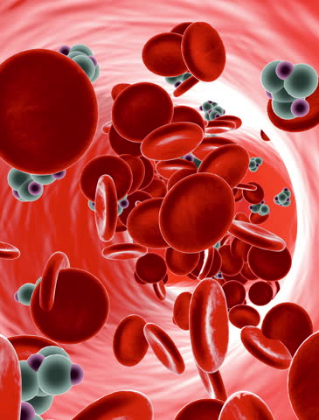

Physics Informed Neural Networks for Fluid Dynamics
NAPDE Course Project
Tutors: Stefano Pagani, Francesco Regazzoni
Students: Giulia Mescolini, Luca Sosta

Slide 2

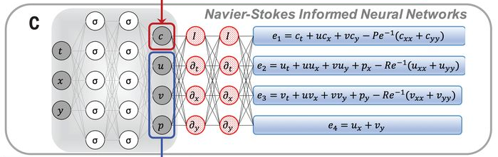
The idea
In the Fluid Dynamics framework we often meet problems involving PDEs which cannot be solved analitically.
In fact, in this field many applications require to reconstruct numerically the behavior of pressure and velocity, starting from partial measures.

Slide 3
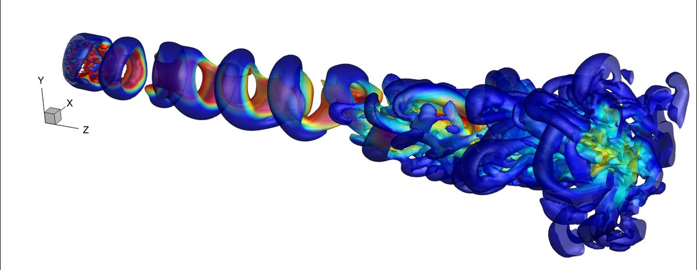
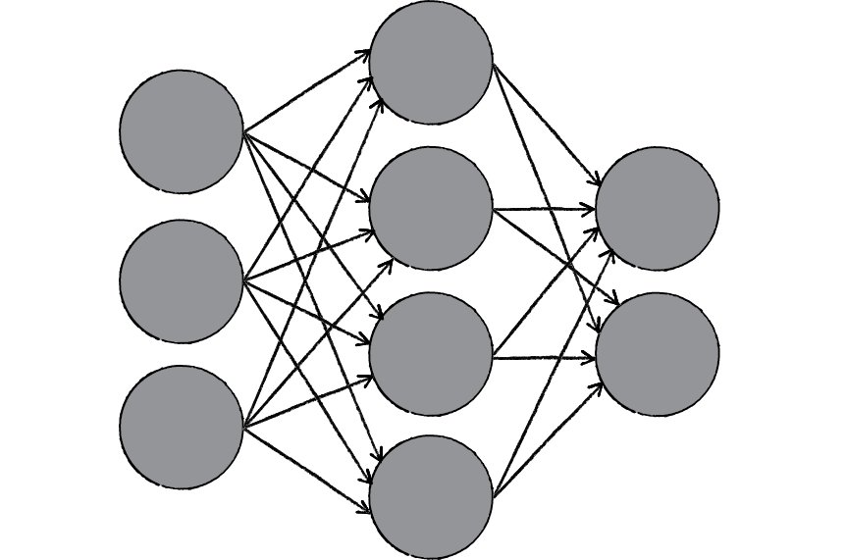

What is a PINN?
PINNs are Neural Networks trained to solve supervised learning tasks while respecting any given law of physics described by general nonlinear partial differential equations.
For our project, the reference library for the automatic differentiation is nisaba, a Python Library built on the top of Tensorflow.
nisaba

Slide 4
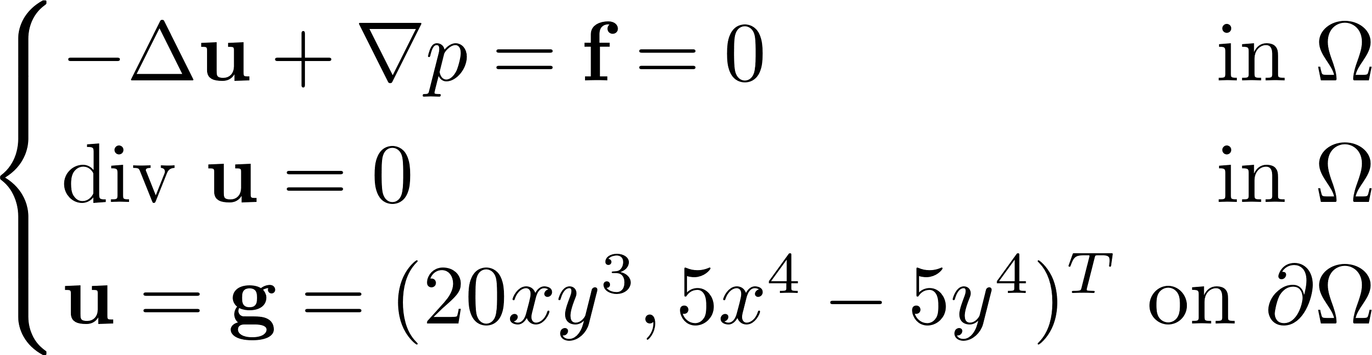
A simple test case
We started from the Colliding Flows benchmark case, whose analytical solution is known:
CHALLENGE:
Train the PINN only with data on the BCs for the velocities and by constraining the mean value of the pressure!

Slide 5
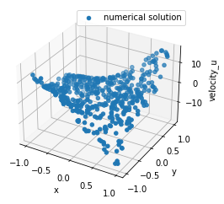
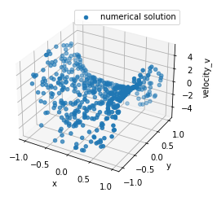
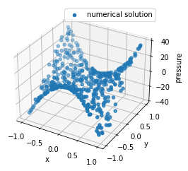
The results
2000 epochs, no noise on data

Slide 6
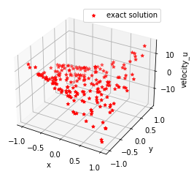
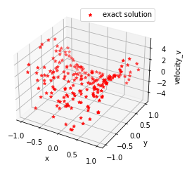
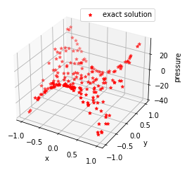
The results
2000 epochs, no noise on data

Slide 7
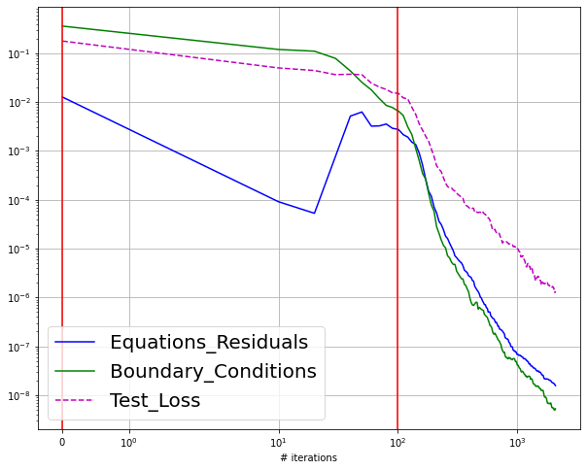
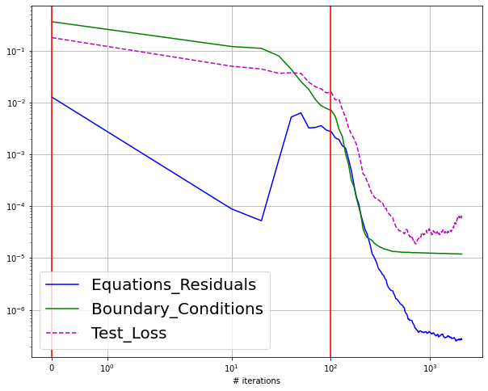

The results
2000 epochs, no noise on data
2000 epochs, with gaussian noise ($μ=0, σ=1$) on data

Slide 8
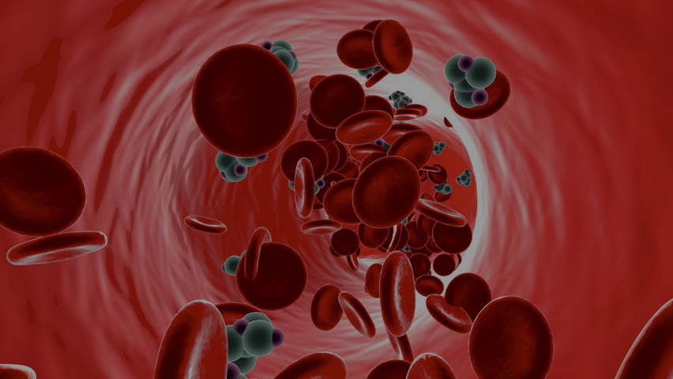

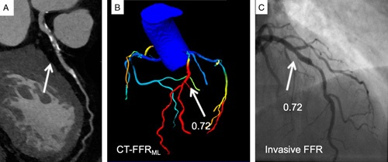
Our prospect
Our next step is to apply this strategy to a test case more complex and closer to reality, such as the Coronary Flow Assessment, fundamental to evaluate coronary artery disease. In this case, there is no hope for an analytical solution.

Slide 9
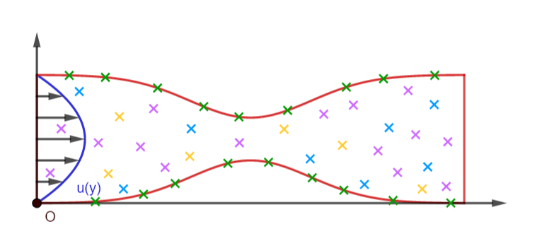
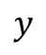
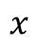
Work Plan
To train our Neural Network, we plan to exploit two types of information:
Geometrical Data
(eg: branch length, vessel radius…)
+
Data on velocity (provided by medical imaging)
$$y$$
Legend:
x Boundary Points
x Training Points
x Collocation Points
x Test Points
$$x$$

Slide 10
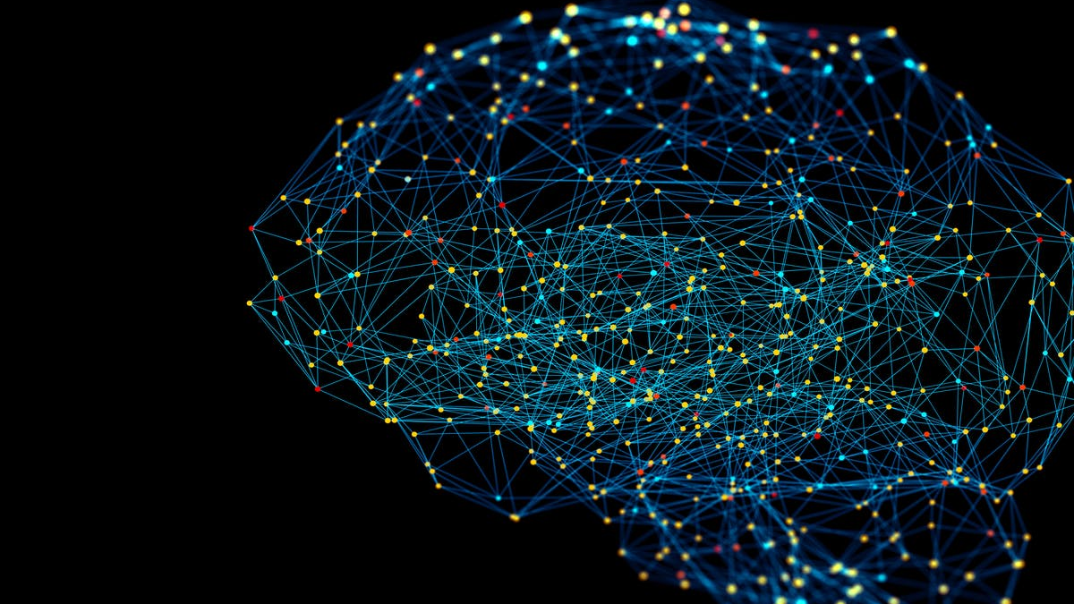
Bibliography
Hidden fluid mechanics: Learning velocity and pressure fields from flow visualizations - Maziar Raissi; Alireza Yazdani; George Em Karniadakis
Machine Learning and Deep Neural Networks Applications in Coronary Flow Assessment - Christian Tesche; Hunter N.Gray
Physics-informed neural networks (PINNs) for fluid mechanics: A review - Shengze Cai; Zhiping Mao; Zhicheng Wang; Minglang Yin; George Em Karniadakis

Slide 11

Thank you for your attention!

